Slide 1
Analyzing Health Equity Using Household Survey Data
Lecture 8
Concentration Index
Notes:
Concentration curves introduced in the previous lecture can be used to identify whether socioeconomic inequality in some health sector variable exists and whether it is more pronounced at one point in time than another or in one country than another. But a concentration curve does not give a measure of the magnitude of inequality that can be compared conveniently across many time periods, countries, regions, or whatever may be chosen for comparison. The concentration index (Kakwani 1977, 1980), which is directly related to the concentration curve, does quantify the degree of socioeconomic-related inequality in a health variable (Kakwani, Wagstaff, and van Doorslaer 1997; Wagstaff, van Doorslaer, and Paci 1989). It has been used, for example, to measure and to compare the degree of socioeconomic-related inequality in child mortality (Wagstaff 2000), child immunization (Gwatkin et al. 2003), child malnutrition (Wagstaff, van Doorslaer, and Watanabe 2003), adult health (van Doorslaer et al. 1997), health subsidies (O’Donnell et al. forthcoming), and health care utilization (van Doorslaer et al. 2006). Many other applications are possible.
In this lecture we define the concentration index, comment on its properties, and identify the required measurement properties of health sector variables to which it can be applied. We also describe how to compute the concentration index and how to obtain a standard error for it, both for grouped data and for microdata.

Slide 2
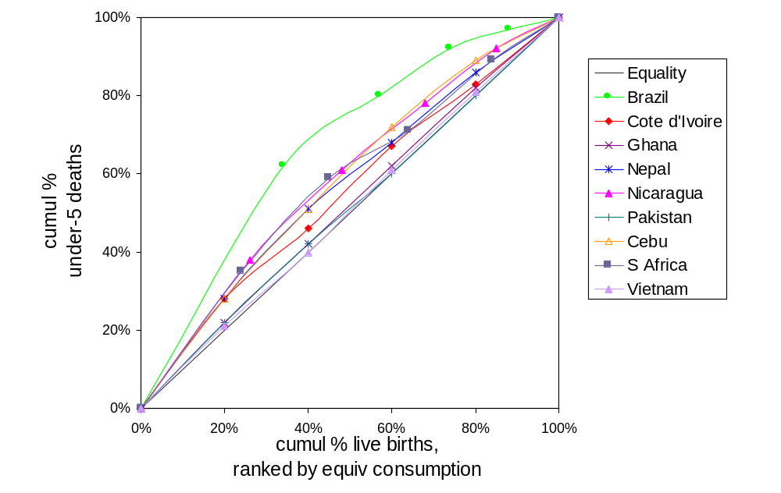
Can you compare the degree of inequality in child mortality across these countries?
Brazil is most unequal,
but how do the rest compare?
Notes:
To illustrate the usefulness of the concentration index relative to the concentration curve, we begin with an example.
Source: Wagstaff, A., Socioeconomic inequalities in child mortality: comparisons across nine developing countries. Bulletin of the World Health Organization, 2000. 78(1): p. 19-29.
Point to be made is that it is difficult to compare many concentration curves, particularly when they lie close together. A ranking is not easily established. Could perform a series of two-way dominance tests. See lecture 12 for an example of this.

Slide 3
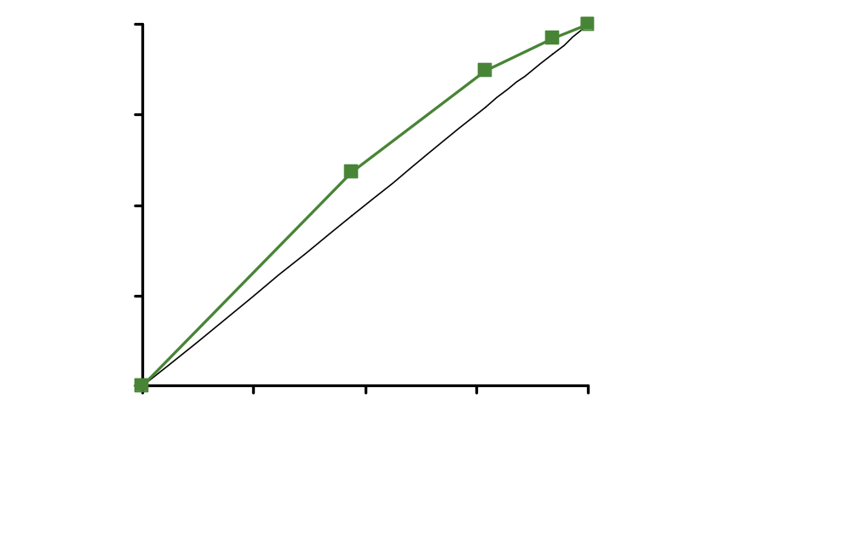
Concentration index (CI)
CI = 2 x area
between 45⁰ line and
concentration curve
CI < 0 when variable
is higher amongst poor
Notes:
7
The concentration index provides a summary measure of the magnitude of socioeconomic-related inequality in a health variable of interest.
Comparing a set of numbers can give a clearer ranking when trying to compare inequality across a number of countries, regions or time periods. But must acknowledge that the index loses information relative to the concentration curve. It summarises the distribution in one number of so does not indicate at what points in the distribution there are departures from proportionality. The concentration index should be used in tandem with the concentration curve.

Slide 4
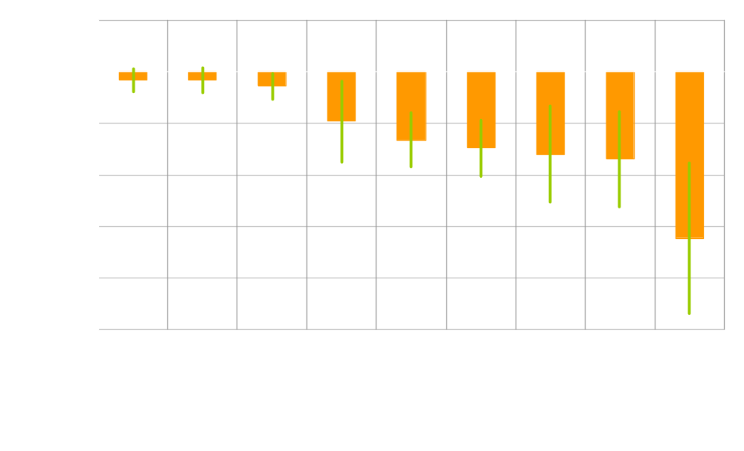
Concentration indices for U5MR
.
Notes:
Now a ranking of the countries in terms of the degree of inequality is more apparent.
95% confidence intervals are given in green.
But one should be a little careful about reaching conclusions about relative degrees of inequality on the basis of comparison of these indices. We cannot reach conclusions about dominance. The concentration index is a summary measure and requires the imposition of judgments about where in the distribution departures from proportionality are more and less desirable. Dominance tests are free of such judgments. They are more general. Related point is that the concentration index will give a ranking in terms of inequality even when the underlying concentration curves cross. A dominance test would not reach a conclusion in such a case. But the comparison of concentration indices can because of the imposition of judgments.

Slide 5
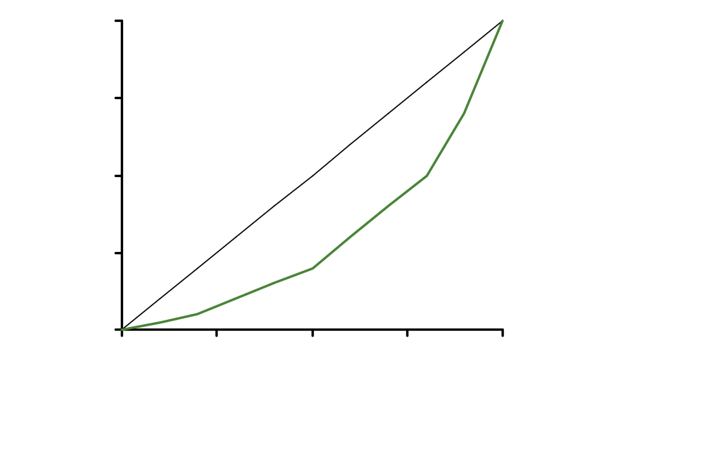

Concentration index defined
C = 2 x area
between 45⁰ line and concentration curve
= A/(A+B)
C>0 (<0) if health variable is disproportionately concentrated on rich (poor)
C=0 if distribution in proportionate
C lies in range (-1,1)
C=1 if richest person has all of the health variable
C=-1 of poorest person has all of the health variable
A
B
Notes:
7
The positive/negative sign for pro-poor/pro-poor distribution is simply convention.
Note that although a proportionate distribution i.e. the concentration curve lying on top of the 45o line is sufficient for the index to take a value of zero, it is not necessary. The concentration curve could cross the 45o line and give a concentration index of zero. Hence it is always advisable to examine both the concentration curve and the index.

Slide 6
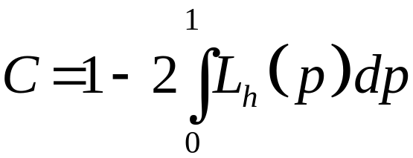
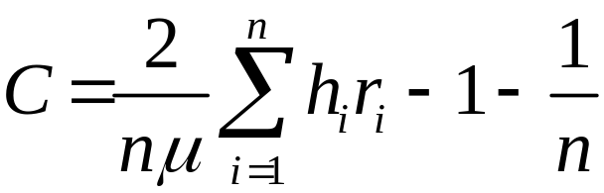
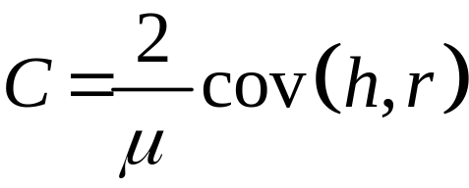
Some formulae for the concentration index
If the living standards variable is discrete:
where n is sample size, h the
health variable, μ its mean and
r the fractional rank by income
For computation, this is more convenient:
Notes:
The first formula defines the concentration index as 1 minus twice the area under the concentration curve. In relation to the diagram on the previous slide, we have C=1-2B. Since B=0.5-A, C=2A. And A/(A+B)=A/(A+0.5-A)=A/0.5=2A.
The second formula makes it more clear that the index reflects the relationship between the health variable and rank in the income distribution. For large N, the final term approaches zero and is often omitted.
The final formula makes even more explicit how the concentration index is relation to the correlation between the health variable and rank in the income (living standards) distribution. In fact, it is the covariance between these two variables scaled by 2 divided by the mean of the health variable.
Note that the concentration index depends only on the relationship between the health variable and the rank of the living standards variable and not on the variation in the living standards variable itself. A change in the degree of income inequality need not affect the concentration index measure of income-related health inequality.

Slide 7
Properties of the concentration index
depend on the measurement characteristics of the health variable of interest.
Strictly, requires ratio scaled, non-negative variable
Invariant to multiplication by scalar
But not to any linear transformation
So, not appropriate for interval scaled variable with arbitrary mean
This can be problematic for measures of health that are often ordinal
If variable is dichotomous, C lies in the interval (μ-1, 1-μ) (Wagstaff, 2005):
  So interval shrinks as mean rises.
  Normalise by dividing C by 1-μ
Notes:
A ratio scale has a true zero, allowing statements such as “A has twice as much X as B.” That makes sense for dollars or height. But many aspects of health cannot be measured in this way.
The concentration index is invariant to multiplication of the health sector variable of interest by any scalar (Kakwani 1980). So, for example, if we are measuring inequality in payments for health care, it does not matter whether payments are measured in local currency or in dollars; the concentration index will be the same. Similarly, it does not matter whether health care is analyzed in terms of utilization per month or if monthly data are multiplied by 12 to give yearly figures.
Measurement of health inequality often relies on self-reported indicators of health, such as those considered in chapter 5. A concentration index cannot be computed directly from such categorical data. Although the ordinal data can be transformed into some cardinal measure and a concentration index computed for this (van Doorslaer and Jones 2003; Wagstaff and van Doorslaer 1994), the value of the index will depend on the transformation chosen (Erreygers 2006).In cross-country comparisons, even if all countries adopt the same transformation, their ranking by the concentration index could be sensitive to differences in the means of health that are used in the transformation.
The bounds given in the case of a dichotomous measure hold for large samples.

Slide 8
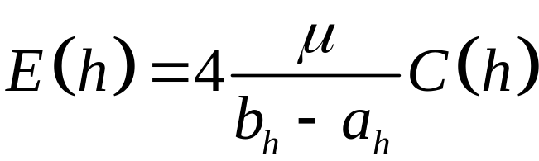
Erreygers (2006) modified concentration index
This satisfies the following axioms:
  Level independence: E(h*)=E(h), h*=k+h
  Cardinal consistency: E(h*)=E(h), h*=k+gH, k>0, g>0
  Mirror: E(h)=-E(s), s=b_{h}-h
  Monotonicity
  Transfer
Where b_{h} and a_{h} are the max and min
of the health variable (h)
Notes:
Erreygers, G (2006) Correcting the concentration index, mimeo University of Antwerp, guido.erreygers@ua.ac.be
From the formula, one can see that this is a normalisation of the concentration index (C(h)) through adjustment by the mean and the bounds of the health variable.
The first three properties are those required to deal with the problems identified on the previous slide that exist when the variable of interest is not measured on a ratio scale.
Level independence means that adding a constant to the health variable of all observations will not change the measure of inequality. This ensures that if we start with everyone having the same level of health, the index is zero, then changing everyone’s health by the same amount does not change the index.
Cardinal consistency ensures that the index is invariant to any positive linear transformation. This is necessary if the variable of interest does not have a true zero. In that case, the mean of the variable is essentially arbitrary and so one wants to ensure that the value of the index is invariant to the scaling chosen for the health variable.
The mirror condition requires that the measure of inequality in health (h) and in ill-health (s) are equal in absolute value, but of opposite sign. This ensures that, say, measuring inequality in the proportion children that die gives the same result as measuring inequality in the proportion that survive. The standard concentration index does not have this property.
Montonicity requires that the index increases when the health of a rich person improves and it decreases when the health of a poor person improves. The concentration index does not have this property.
The final axiom is a variant on the well-known principle of transfers examined in the income distribution literature. It can be stated as follows:
“Suppose the health of person j increases by a certain amount and the health of person k decreases by the same amount.
If person j is richer than person k, the value of E(h) increases; if person j is poorer than person k, the value of E(h) decreases. “ (Erreygers, 2006, p.13).
The concentration index does satisfy this axiom (Bleichrodt and van Doorslaer, 2006).
The concentration index satisfies only the transfer condition. Wagstaff’s normalised concentration index satisfies transfer, cardinal consistency and mirror conditions.

Slide 9
Interpreting the concentration index
How “bad” is a C of 0.10?
Does a doubling of C imply a doubling of inequality?
Koolman & van Doorslaer (2004) –
  75C = % of health variable that must be (linearly) transferred from richer to poorer half of pop. to arrive at distribution with a C of zero
  But this ensures equality of health predicted by income rank and not equality per se
Notes:
1. Koolman and Van Doorslaer (2004) also consider other redistribution schemes. A linear redistribution means that an income rank increases by 1 the transfer changes by the same amount across the full range of the income distribution. That is, akin to a tax with a single tax rate proportionate to income.

Slide 10
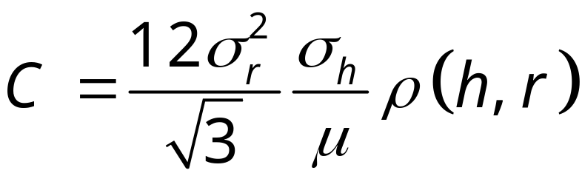
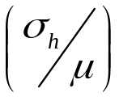

Inequality is not simply correlation
Milanovic (1997) decomposition for Gini can be adapted for concentration index:
C is (scaled) product of coefficient of variation and correlation
  C captures both association and variability
  C is a covariance scaled in interval [-1,1]
  same association can imply different inequality depending on variability
Notes:
1. Since the variance of the income rank is goes to 1/12 as the sample size increases, the first term in the decomposition can be considered a constant. Then the concentration index depends only on the coefficient of variation of the health variable and its correlation with the income rank.

Slide 11
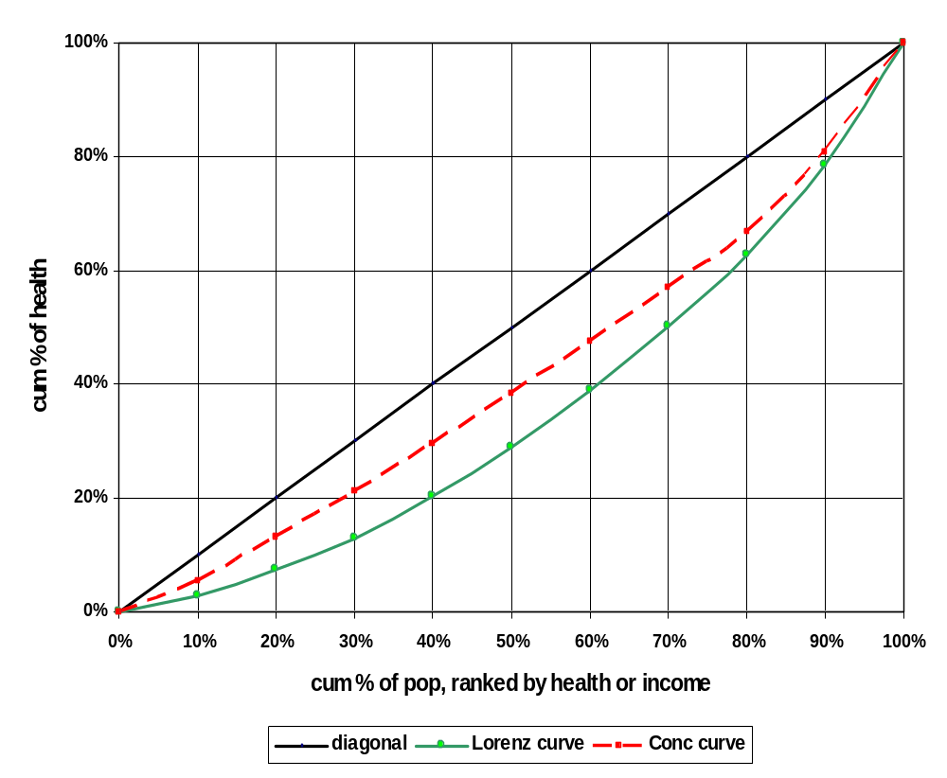
Total inequality in health and socioeconomic-related health inequality
By definition, the
health Lorenz curve
must lie below the
concentration curve.
That is, total health
inequality is greater
than income-related
health inequality.
Notes:
The Lorenz curve for income describes the income distribution. It plots the cumulative proportion of income against the cumulative proportion of the population ranked by income.
A plot of the cumulative proportion of health against the cumulative proportion of the population ranked by health is the health Lorenz curve. Since this runs from the least to the most healthy person, the proportion of health accounted for by the least healthy 10% is necessarily less the proportion of health accounted for by the poorest 10% (unless health and income are perfectly positively correlated).
But for many health variables available from survey data, which are categorical, the health Lorenz curve would not be very interesting since there are relatively few values of health by which to rank. For anthropometric indicators it would be interesting.

Slide 12
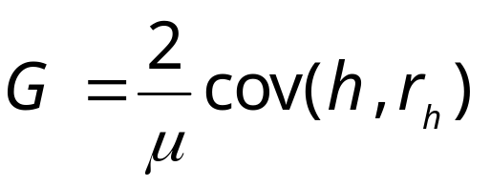
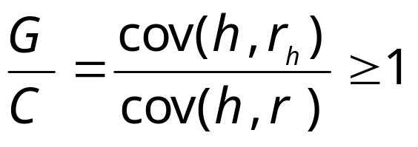
Total inequality in health is larger than socioeconomic-related health inequality
Gini index of total health inequality
Then
Thus, G = C + R, where R>=0 and measures the outward move from the health concentration curve to the health Lorenz curve, or the re-ranking in moving from the SES to the health distribution
“even if the social class gradient was magically eliminated, dispersion in health outcomes in the population would remain very much the same”
Smith J, 1999, Healthy bodies and thick wallets”, J Econ Perspectives
r_{h} is rank in health distribution
Notes:
Point here is that the total dispersion in health, which can be measured by the Gini coefficient with individuals ranked by health, is necessarily greater than socioeconomic-related health inequality and it is likely to be much larger.
But some differences in health may be considered less fair than others. While it might be accepted that health differences will arise from luck and nothing much can be done about this (beyond providing insurance), health differences that arise from socioeconomic circumstances might be considered an infringement on social justice.

Slide 13
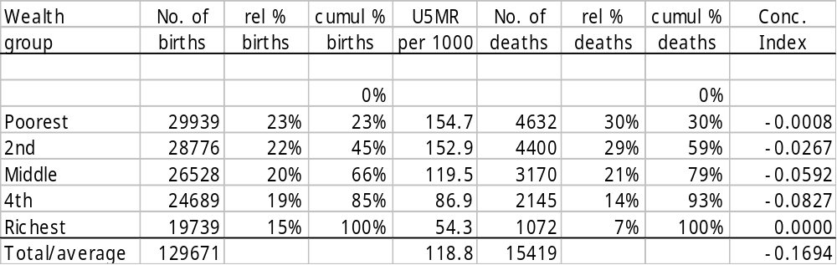
Computing concentration index with grouped data
Under-5 deaths in India
p_{t}
L_{t}
(p_{t-1}L_{t}-p_{t}L_{t-1})
Notes:
In the formula, p_t is the cumulative percentage of the sample ranked by economic status in group t, and L_t is the corresponding concentration curve ordinate.
To illustrate, consider the distribution of under-five mortality by wealth quintiles in India, 1982–92. We drew the concentration curve for these data in lecture 7.
In the table the terms in brackets in the formula are in the the final column. The sum of these terms is –0.1694, which is the concentration index. The negative concentration index reflects the higher mortality rates among poorer children.
A standard error for the concentration index estimated from grouped data can be calculated from a formula given by Kakwani et al (1997) – see chapter 8 in AHE. The formula differs depending upon whether the group variances are known or not.

Slide 14
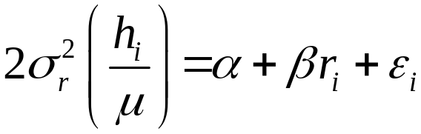
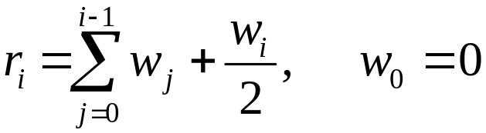
Estimating the concentration index from micro data
Use “convenient covariance” formula C=2cov(h,r)/μ
  Weights applied in computation of mean, covar and rank
Equivalently, use “convenient regression”
  Where the fractional rank (r) is calculated as follows if there are weights (w)
  OLS estimate of β is the estimate of the concentration index
Notes:
The left-hand-side variable in the regression is a transformation of the health variable if interest, i.e. it is multiplied by twice the variance of the income rank (which approaches 1/12 for large samples) and divided by its mean. The only right-hand-side variable is the fractional income rank. A constant is included.
The weighted fractional rank is the cumulative sum of weights (scaled to sum to 1) to the preceding observation plus half the observations own weight. With observations ranked from poorest to richest by the living standards vairable.
It is important to understand that regression is being used here only as a computation device. No model is being proposed. No assumptions about the distribution of the error term need hold for OLS to give the estimate of the concentration index.
The regression method gives rise to an alternative interpretation of the concentration index as the slope of a line passing through the heads of a parade of people, ranked by their living standards, with each individual’s height proportional to the value of his or her health variable, expressed as a fraction of the mean.
Computation in Stata is given in the associated do-file.

Slide 15
Standard error of the estimate of the concentration index
Kakwani et al (1997) provide a formula for delta-method SE
  But formula does not take account of weights or sample design
Could use the SE from the convenient regression
  Allows adjustment for weights, clustering, serial correlation, etc
  But that does not take account of the sampling variability of the estimate of the mean
Notes:
Kakwani, Wagstaff, and van Doorslaer (1997) derived the standard error of an estimate of the concentration estimated by noting that the concentration index can be written as a nonlinear function of totals, and so the delta method (Rao 1965) can be applied to obtain the standard error.
The formula given in Kakwani et al does not take account of weights, clustering etc. In principle, this could be done but it has not yet been derived.
Serial correlation is likely to be present due to the rank nature of the independent variable. Newey-West standard errors can be computed to take account of this.

Slide 16

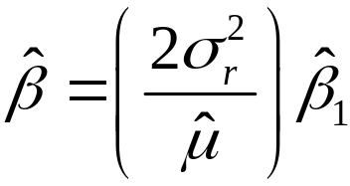
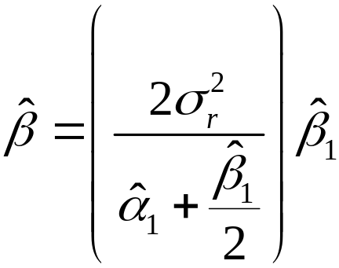
Delta method standard error from convenient regression
To take account of the sampling variability of the
estimate of the mean, run this regression
Estimate the concentration index from
Or using the properties of OLS
This estimate is a non-linear
function of the regression
coeffs and so its standard error can be obtained by the
delta method.
Notes:
In going from the second to third formula we use the fact that the mean of the OLS prediction is equal to the mean of the dependent variable and that the mean of the fractional rank is 0.5.
Stata code is given in the do-file. Weights, clustering and serial correlation can be taken into account.

Slide 17
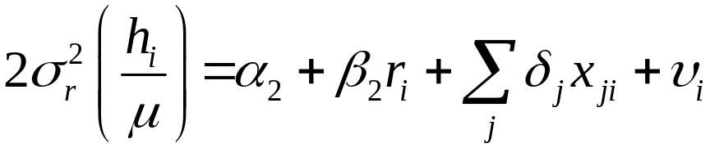
Demographic standardization of the concentration index
Can use either method of standardization presented in lecture 5 & compute the C index for the standardized distribution
If want to standardized for the total correlation with demographic confounding variables (x), then can do in one-step
OLS estimate of β₂ is indirectly standardized concentration index
Notes:
The two-step method would involve first computing the standardized health variable for each observation and then computing the concentration index for this variable.
The one-step method is obviously more convenient but it does not allow one to include control variables in the standardization process. That is, one cannot standardized only for the partial correlations between the health variable and the confounding demographics.

Slide 18
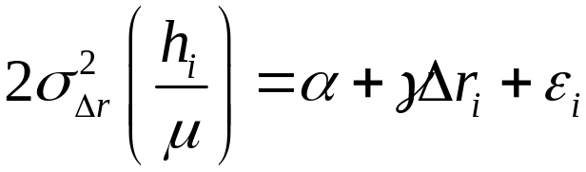



Sensitivity of the concentration index to the living standards measure
C reflects covariance between health and rank in the living standards distribution
C will differ across living standards measures if re-ranking of individuals is correlated with health (Wagstaff & Watanabe, 2003)
From OLS estimate of
where is the re-ranking and
its variance,
the difference in concentration indices is
Notes:
1. The regression makes clear that a change in the living standards measure will change in the concentration index if the differential ranking on observations across the two measures is correlated with their level of health. For example, if the less health tend to be ranked lower on income than on wealth.

Slide 19
Evidence on sensitivity of concentration index
Wagstaff & Watanabe (2003) – signif. difference b/w C estimated from consumption and assets index in only 6/19 cases for underweight and stunting
But Lindelow (2006) find greater sensitivity in concentration indices for health service utilization in Mozambique
 | Consumption |  |  | Asset index |  |  | Difference CI_{C} – CI_{AI} | t-value for difference
 | CI | t-value |  | CI | t-value
Hospital visits | 0.166 | 8.72 |  | 0.231 | 12.94 |  | -0.065 | ‑3.35
Health center visits | 0.066 | 3.85 |  | ‑0.136 | ‑8.49 |  | 0.202 | 9.99
Complete immunizations | 0.059 | 8.35 |  | 0.194 | 34.69 |  | ‑0.135 | ‑19.1
Delivery control | 0.063 | 11.86 |  | 0.154 | 35.01 |  | ‑0.091 | ‑15.27
Institutional delivery | 0.089 | 11.31 |  | 0.266 | 43.26 |  | ‑0.176 | ‑20.06
Notes:
For 19 countries, Wagstaff and Watanabe (2003) test the sensitivity of the concentration index for child malnutrition to the use of household consumption and a wealth index as the living standards ranking variable . Malnutrition is measured by a binary indicator of underweight and another for stunting (see chapter 4). For each of underweight and stunting, the difference between the concentration indices is significant (10%) for 6 of 19 comparisons. This suggests that in the majority of countries, child nutritional status is not strongly correlated with inconsistencies in the ranking of households by consumption and wealth.
But there is some evidence that concentration indices for health service utilization are more sensitive to the living standards measure. The table shows substantial and significant differences between the concentration indices (CI) for a variety of health services in Mozambique using consumption and an asset index as the living standards measure. In the case of consumption, the concentration index indicates statistically significant inequality in favor of richer households for all services. With households ranked by the asset index rather than consumption, the inequality is greater for all services except health center visits, for which the concentration index indicates inequality in utilization in favor of poorer households.

